Slide 1
SystemDS: A Declarative ML System for the End-to-End Data Science Lifecycle
TU Graz, Institute of Interactive Systems and Data Science

Slide 2

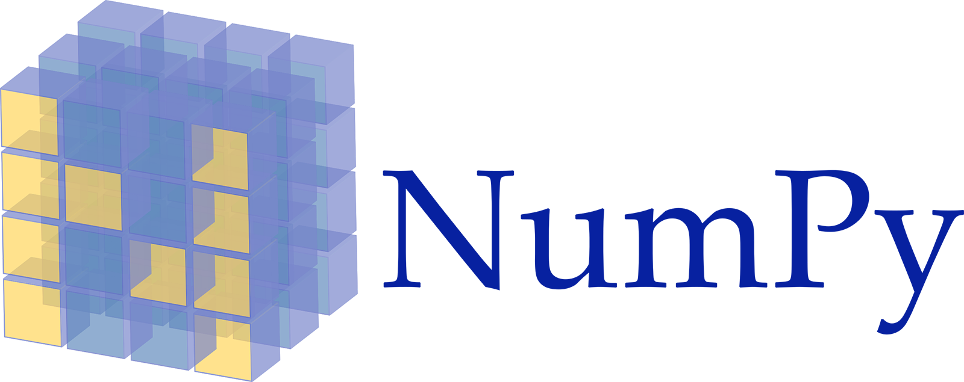



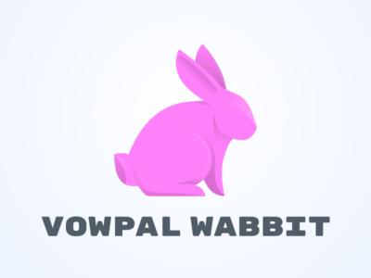








Motivation SystemDS
Existing ML Systems
#1 Numerical computing frameworks
#2 ML Algorithm libraries (local, large-scale)
#3 Linear algebra ML systems (large-scale)
#4 Deep neural network (DNN) frameworks
#5 Model management, and deployment
Exploratory Data-Science Lifecycle
Open-ended problems w/ underspecified objectives
Hypotheses, data integration, run analytics
Unknown value → lack of system infrastructure → Redundancy of manual efforts and computation
Data Preparation Problem
80% Argument: 80-90% time for finding, integrating, cleaning data
Diversity of tools ➔ boundary crossing, lack of optimization
In-DBMS ML toolkits largely unsuccessful (stateful, data loading, verbose)
“Take these datasets and show value or competitive advantage”

Slide 3
Motivation SystemDS, cont.
[Xin Luna Dong, Theodoros Rekatsinas: Data Integration and Machine Learning: A Natural Synergy. SIGMOD 2018]
Key Observation
SotA data integration based on ML (e.g., data extraction, schema alignment, entity linking)
Similar: data cleaning, outlier detection, missing value imputation, semantic type detection, data augmentation, feature selection, hyper parameter optimization, model debugging
A Case for Declarative Data Science
High-level abstractions (R/Python, stateless) for lifecycle tasks, implemented in DSL for ML training/scoring
Avoid boundary crossing and optimizations across lifecycle
Control compiler and runtime of utmost importance
Apache SystemML → SystemDS
Architecture and Preliminary Results

Slide 4
SystemML Background

Slide 5
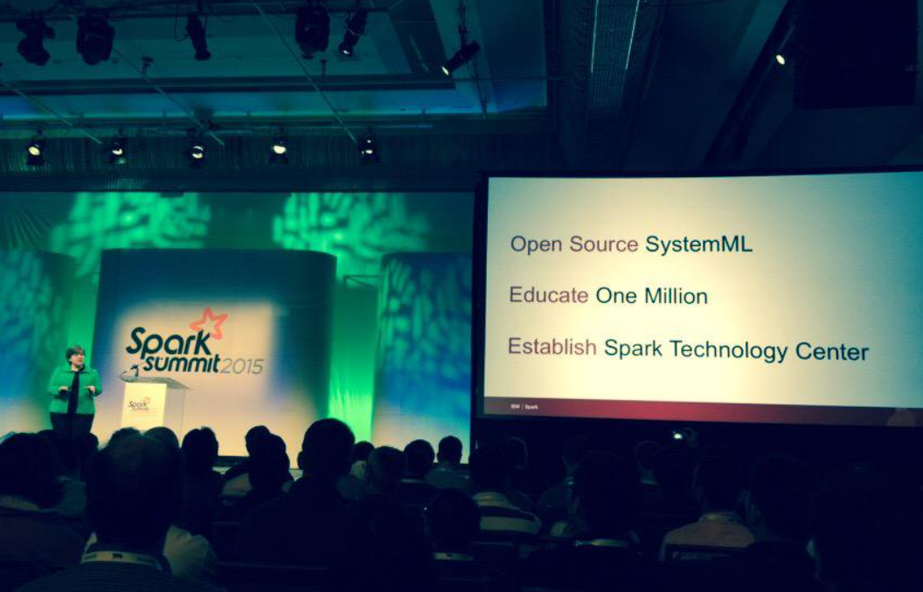



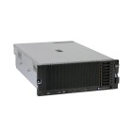
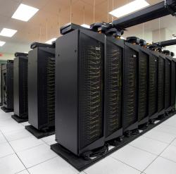
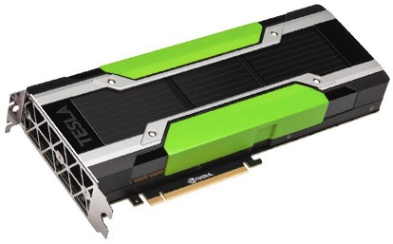
High-Level SystemML Architecture
Apache SystemML Background
DML Scripts
APIs: Command line, JMLC, Spark MLContext, Spark ML, (20+ scalable algorithms)
Language
Compiler
[SIGMOD’15,’17,‘19]
[PVLDB’14,’16a,’16b,’18]
[ICDE’11,’12,’15]
[CIDR’17]
[VLDBJ’18] [DEBull’14]
[PPoPP’15]
Runtime
05/2017 Apache Top-Level Project 11/2015 Apache Incubator Project
08/2015 Open Source Release
In-Memory Single Node (scale-up)
Hadoop or Spark Cluster (scale-out)
In-Progress:
GPU
since 2014/16
since 2012
since 2010/11
since 2015

Slide 6

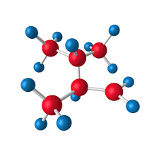
Lessons Learned from SystemML
Apache SystemML Background
Why was SystemML not adopted in practice?
L1 Data Independence & Logical Operations
Independence of evolving technology stack (MR → Spark, GPUs)
Simplifies development (libs) and deployment (large-scale vs. embedded)
Enables adaptation to cluster/data characteristics (dense/spare/compressed)
L2 User Categories (|Alg. Users| >> |Alg. Developers|)
Focus on ML researchers and algorithm developers is a niche
Data scientists and domain experts need higher-level abstractions
L3 Diversity of ML Algorithms & Apps
Variety of algorithms (batch 1st/2nd, mini-batch DNNs, hybrid)
Different parallelization, ML + rules, numerical computing
L4 Heterogeneous Structured Data
Support for feature transformations on 2D frames
Many apps deal with heterogeneous data and various structure

Slide 7
SystemDS Architecture (An open source ML System for the end-to-end Data Science lifecycle )
https://github.com/tugraz-isds/systemds,
forked from Apache SystemML 1.2 in Sep 2018
SystemDS 0.1 published Aug 31, 2019 SystemDS 0.2 upcoming

Slide 8
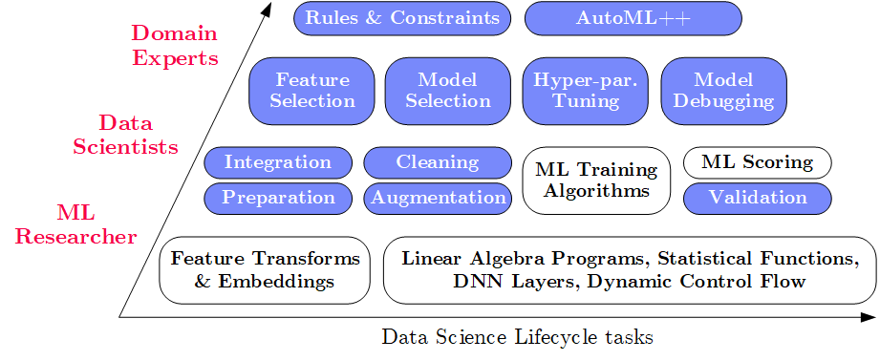
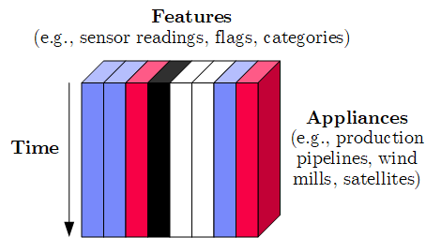
SystemDS Vision and Design
SystemDS Architecture
Game Plan
Objectives
Effective and efficient data preparation, ML, and model debugging at scale
High-level abstractions for lifecycle tasks (L3/L4) and users (L2)
#1 Based on DSL for ML Training/Scoring
Hierarchy of abstractions for DS tasks
ML-based SotA, interleaved, performance
#2 Hybrid Runtime Plans and Optimizing Compiler
System infrastructure for diversity of algorithm classes
Different parallelization strategies and new architectures (Federated ML)
Abstractions → redundancy → automatic optimization
#3 Data Model: Heterogeneous Tensors
Data integration/prep requires generic data model

Slide 9
Language Abstractions and APIs, cont.
SystemDS Architecture
Example: Stepwise Linear Regression
User Script
Built-in Functions
X = read(‘features.csv’)
Y = read(‘labels.csv’)
[B,S] = steplm(X, Y,
icpt=0, reg=0.001)
write(B, ‘model.txt’)
m_steplm = function(...) {
while( continue ) {
parfor( i in 1:n ) {
if( !fixed[1,i] ) {
Xi = cbind(Xg, X[,i])
B[,i] = lm(Xi, y, ...)
} }
# add best to Xg # (AIC)
} }
m_lmCG = function(...) {
while( i<maxi&nr2>tgt ) {
q = (t(X) %*% (X %*% p)) + lambda * p
beta = ... }
}
m_lm = function(...) {
if( ncol(X) > 1024 )
B = lmCG(X, y, ...)
else
B = lmDS(X, y, ...)
}
Linear Algebra Programs
Feature Selection
Facilitates optimization across data science lifecycle tasks
ML Algorithms
m_lmDS = function(...) {
l = matrix(reg,ncol(X),1)
A = t(X) %*% X + diag(l)
b = t(X) %*% y
beta = solve(A, b) ...}

Slide 10
System Architecture
SystemDS Architecture

Slide 11
Lineage and Reuse
Preliminary Results
Problem
Exploratory data science (data preprocessing, model configurations)
Reproducibility and explainability of trained models (data, parameters, prep)
➔ Lineage/Provenance as Key Enabling Technique
Model versioning, reuse of intermediates, incremental maintenance, auto differentiation, and debugging (results and intermediates, convergence behavior via query processing over lineage traces)
a) Efficient Lineage Tracing
Tracing of inputs, literals, and non-determinism
Trace lineage of logical operations for all live variables, store along outputs, program/output reconstruction possible:
Proactive deduplication of lineage traces for loops, (and functions)
X = eval(deserialize(serialize(lineage(X))))

Slide 12
Lineage and Reuse, cont.
Preliminary Results
O(k(mn²+n³)) → O(mn²+kn³)
b) Full Reuse of Intermediates
Before executing instruction, probe output lineage in cache Map<Lineage, MatrixBlock>
Cost-based/heuristic caching and eviction decisions (compiler-assisted)
c) Partial Reuse of Intermediates
Problem: Often partial result overlap
Reuse partial results via dedicated rewrites (compensation plans)
Example: steplm
for( i in 1:numModels )
R[,i] = lm(X, y, lambda[i,], ...)
m_lmDS = function(...) {
l = matrix(reg,ncol(X),1)
A = t(X) %*% X + diag(l)
b = t(X) %*% y
beta = solve(A, b) ...}
m_steplm = function(...) {
while( continue ) {
parfor( i in 1:n ) {
if( !fixed[1,i] ) {
Xi = cbind(Xg, X[,i])
B[,i] = lm(Xi, y, ...)
} }
# add best to Xg # (AIC)
} }
X
m>>n
t(X)
O(n²(mn²+n³)) → O(n²(mn+n³))

Slide 13
Experiments (Hyper-Param Opt)
Preliminary Results
Baselines
(TF1.13)
Full Reuse
(TF2.0)
Dense, 100K x 1K
Sparse, 100K x 1K

Slide 14
Experiments (Cross Validation)
Preliminary Results
Full Reuse (TF2.0)
Dense, 100K x 1K
Sparse, 1M x 1K
#1 Competitive baseline performance ML training (dense, sparse)
#2 Large improvements due to fine-grained redundancy elimination

Slide 15


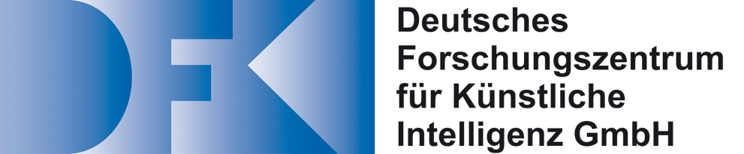


Conclusions
Summary: SystemML is dead, long live SystemDS
Vision and system architecture of SystemDS
Selected research directions and preliminary results
#1 Support for data science lifecycle tasks (data prep, training, debugging), users w/ different expertise (ML researcher, data scientist, domain expert)
#2 Support for local, distributed, and federated ML, optimizing compiler and parallelization strategies
#3 Underlying data model of heterogeneous tensors w/ native support for lineage tracing and exploitation, and automatic data reorganization and specialization
We’re open: use as baseline or testbed, integrate your work
→ Apache SystemDS?

Slide 16
Thanks
https://github.com/tugraz-isds/systemds
Iulian Antonov, Sebastian Baunsgaard, Mark Dokter, Robert Ginthör, Kevin Innerebner, Florijan Klezin, Stefanie Lindstaedt, Philipp Ortner, Norbert Pfeifer, Arnab Phani, Benjamin Rath, Berthold Reinwald, Svetlana Sagadeeva, Afan Secic, Shafaq Siddiqi, Sebastian Benjamin Wrede
as well as entire Apache SystemML team, CIDR reviewers, ExDRa project team

Slide 17
The 80% Argument
SystemDS Motivation
Data Sourcing Effort
Data scientists spend 80-90% time on finding relevant datasets and data integration/cleaning.
Technical Debts in ML Systems
Glue code, pipeline jungles, dead code paths
Plain-old-data types, multiple languages, prototypes
Abstraction and configuration debts
Data testing, reproducibility, process management, and cultural debts
[Michael Stonebraker, Ihab F. Ilyas: Data Integration: The Current Status and the Way Forward. IEEE Data Eng. Bull. 41(2) (2018)]
ML
[D. Sculley et al.: Hidden Technical Debt in Machine Learning Systems. NIPS 2015]

Slide 18
Example: Linear Regression Conjugate Gradient
Apache SystemML Background
1: X = read($1); # n x m matrix
2: y = read($2); # n x 1 vector
3: maxi = 50; lambda = 0.001; 4: intercept = $3;
5: ...
6: r = -(t(X) %*% y);
7: norm_r2 = sum(r * r); p = -r;
8: w = matrix(0, ncol(X), 1); i = 0;
9: while(i<maxi & norm_r2>norm_r2_trgt)
10: {
11: q = (t(X) %*% (X %*% p))+lambda*p;
12: alpha = norm_r2 / sum(p * q);
13: w = w + alpha * p;
14: old_norm_r2 = norm_r2;
15: r = r + alpha * q;
16: norm_r2 = sum(r * r);
17: beta = norm_r2 / old_norm_r2;
18: p = -r + beta * p; i = i + 1;
19: }
20: write(w, $4, format="text");
Note:
#1 Data Independence
#2 Implementation-Agnostic Operations
Read matrices from HDFS/S3
Compute initial gradient
Compute conjugate gradient
Compute step size
Update model and residuals
➔ “Separation of Concerns”

Slide 19
Basic HOP and LOP DAG Compilation
Apache SystemML Background
LinregDS (Direct Solve)
X = read($1);
y = read($2);
intercept = $3;
lambda = 0.001;
...
if( intercept == 1 ) {
ones = matrix(1, nrow(X), 1);
X = append(X, ones);
}
I = matrix(1, ncol(X), 1);
A = t(X) %*% X + diag(I)*lambda;
b = t(X) %*% y;
beta = solve(A, b); ...
write(beta, $4);
Cluster Config:
driver mem: 20 GB
exec mem: 60 GB
Scenario: X: 10⁸ x 10³, 10¹¹ y: 10⁸ x 1, 10⁸
HOP DAG (after rewrites)
8KB
CP
write
8MB
16MB
CP
b(solve)
CP
172KB
b(+)
1.6TB
CP
SP
800GB
r(diag)
ba(+*)
ba(+*)
SP
1.6TB
r(t)
8KB
SP
CP
800GB
800MB
dg(rand) (10³x1,10³)
X
(10⁸x10³,10¹¹)
y (10⁸x1,10⁸)
LOP DAG (after rewrites)
16KB
r’(CP)
Hybrid Runtime Plans:
Size propagation / memory estimates
Integrated CP / Spark runtime
Dynamic recompilation during runtime
Distributed Matrices
Fixed-size (squared) matrix blocks
Data-parallel operations
mapmm(SP)
tsmm(SP)
800MB
1.6GB
r’(CP)
X
X_{1,1}
(persisted in MEM_DISK)
y
X_{2,1}
X_{m,1}

Slide 20
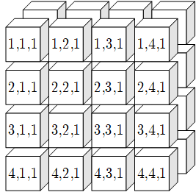
Data Model: Heterogeneous Tensors
SystemDS Architecture
Basic Tensor Block
BasicTensorBlock: homogeneous tensors (FP32, FP64, INT32, INT64, BOOL, STRING/JSON)
DataTensorBlock: composed from basic TBs
Represents local tensor (CPU/GPU)
Distributed Tensor Representation
Collection of fix-sized tensor blocks
Squared blocking schemes in n-dim space (e.g., 1024^2, 128^3, 32^4, 16^5, 8^6, 8^7)
PairRDD<TensorIndex,TensorBlock>
Federated Tensor Representation
Collection of meta data handles to TensorObjects, each of which might refer to data on a different worker instance (local or distributed)
Generalizes to federated tensors of CPU and GPU data objects

